Slide 1


Using Quartus
Presenters:
Najmeh Nazari
September 2020
1

Slide 2
Outline
FPGA Structure
PLD Design Flow
Quartus
2

Slide 3
FPGAs vs. ASICs
ASICs
FPGAs
Off-the-shelf
High performance
Low development costs
Low power
Short time to the market
Low cost (but only
in high volumes)
Reconfigurability

Slide 4
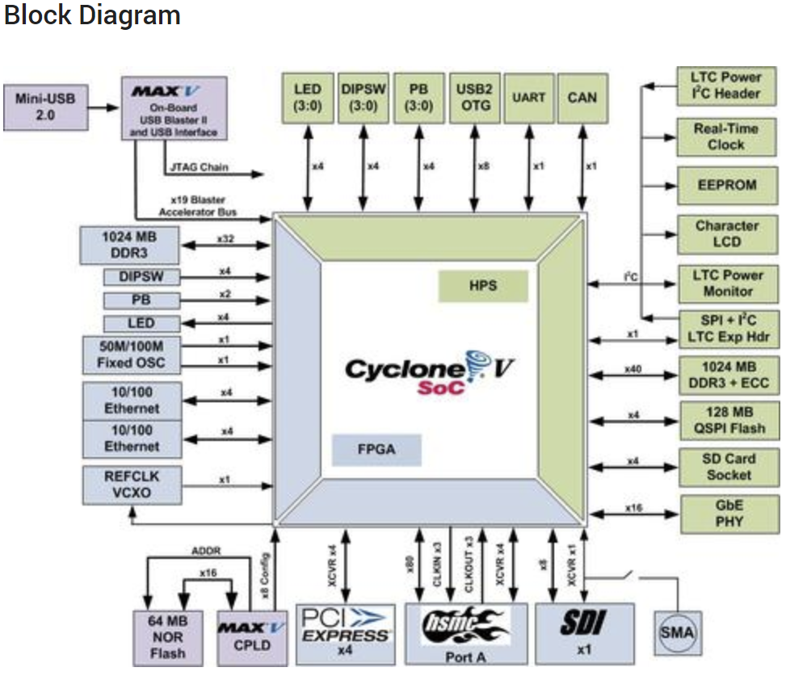
What is an FPGA?
Adaptive Logic
Modules (ALM)
Block RAMs
Block RAMs
I/O
Blocks
Block
RAMs

Slide 5
General structure of an FPGA
The Design Warrior’s Guide to FPGAs Devices, Tools, and Flows. ISBN 0750676043 Copyright © 2004 Mentor Graphics Corp. (www.mentor.com)

Slide 6
Traditional Hardware Design Flow

Slide 7
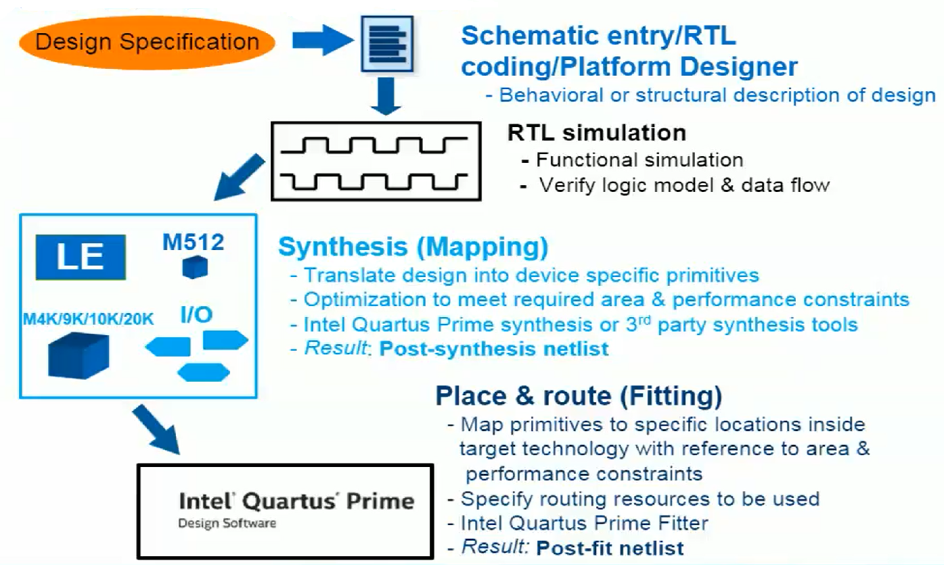
Typical PLD Design Flow
7

Slide 8
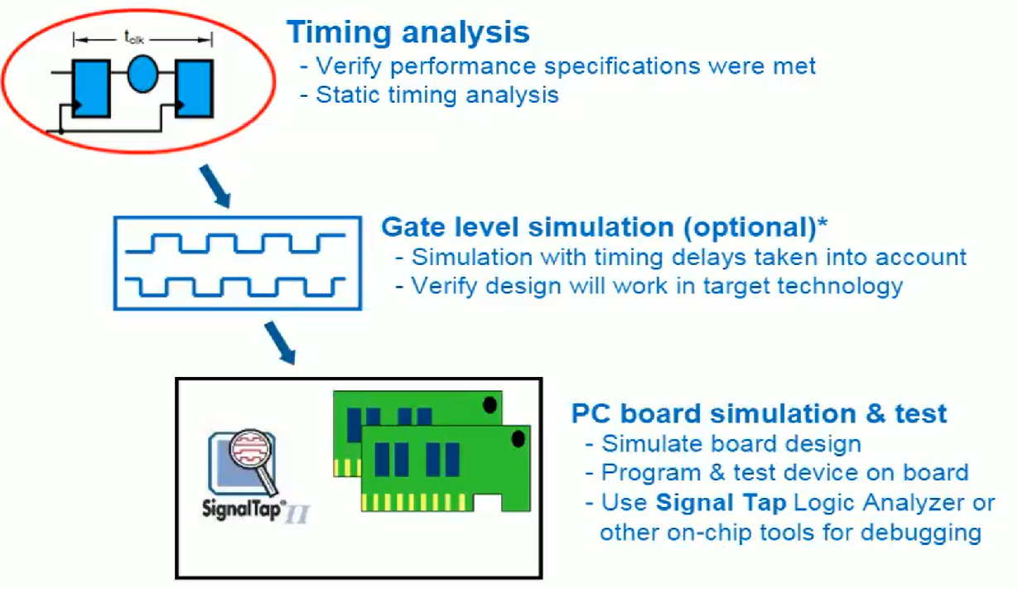
Typical PLD Design Flow
8

Slide 9
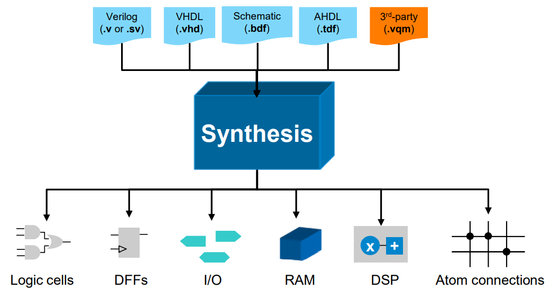
Synthesis
Translate HDL source files into an atom netlist
9

Slide 10
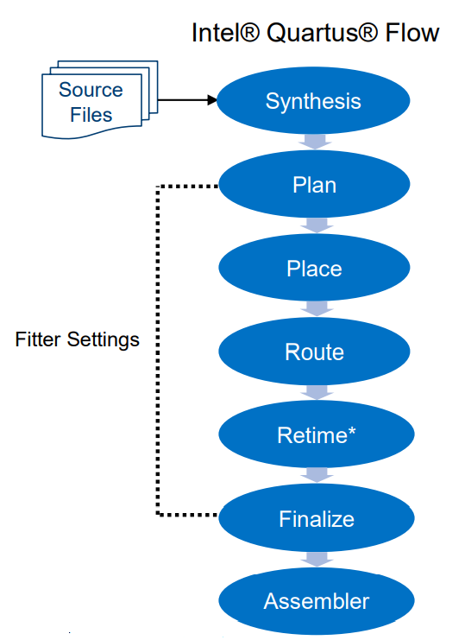
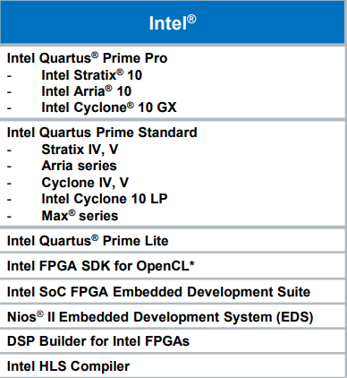
Intel FPGA Compilation Flow
10

Slide 11
Intel Quartus Prime Standard Edition Design Software
Fully-integrated development tool
Multiple design entry methods
Logic synthesis
Place &route
Device Programming
Simulation
Supports standard HDL simulation tool
Includes ModelSim-intel FPGA Starter Edition tool
11

Slide 12
Quartus: Installation and licensing
Follow the links:
Installation:
https://fpgasoftware.intel.com/static/quick_start_guide/quick_start_guide_en.pdf
Licensing: Use free lite version

Slide 13
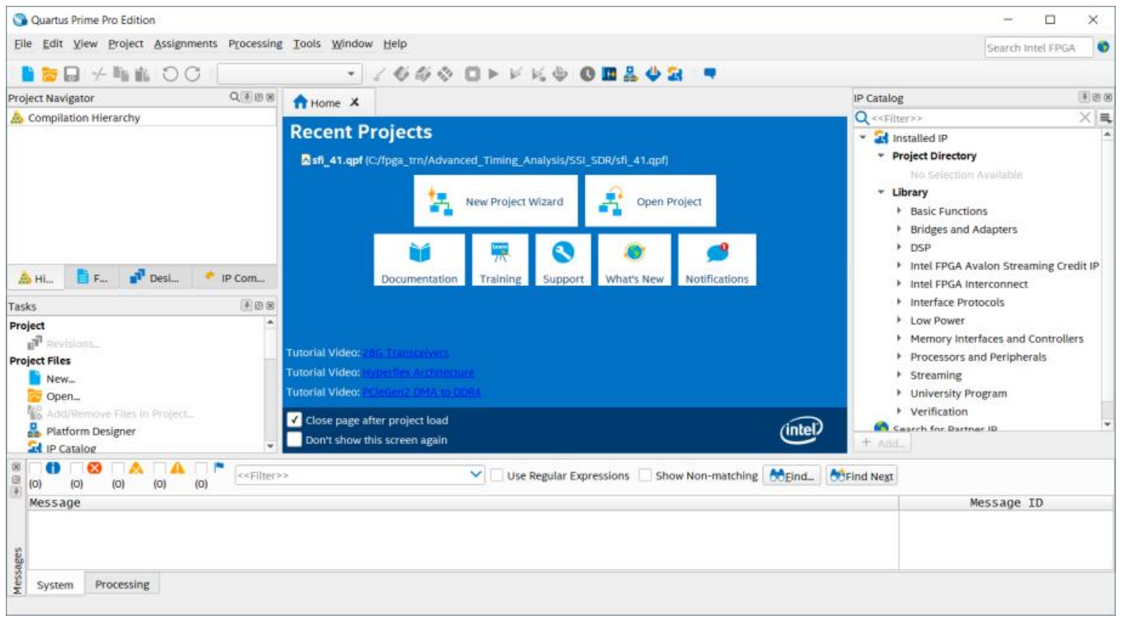
Welcome to the Intel Quartus Prime Design Software
v
13

Slide 14
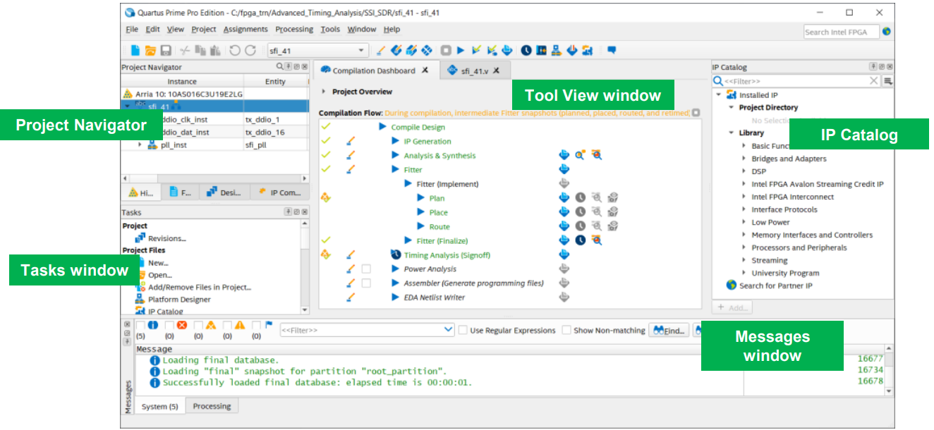
Default Operating Environment
F
14

Slide 15
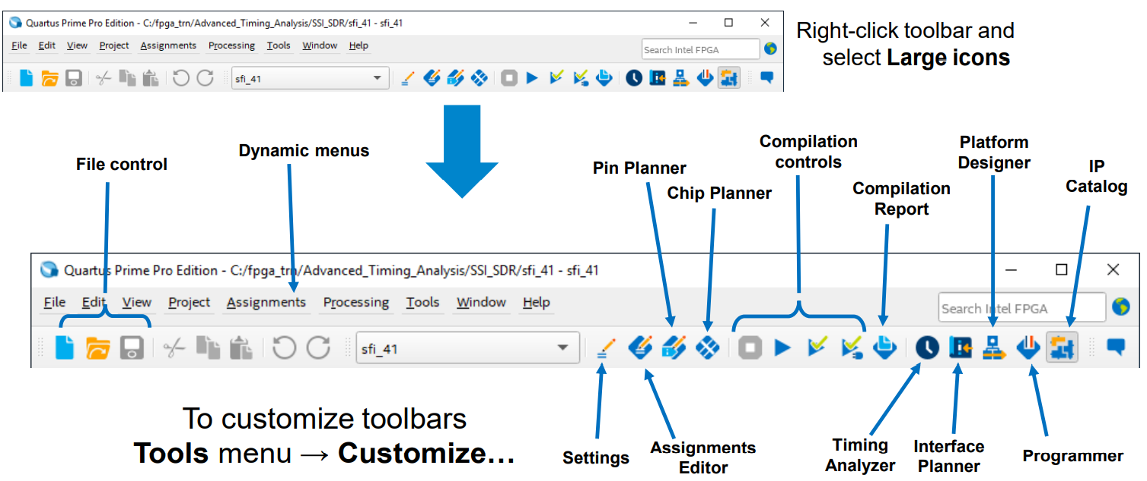
Main Toolbar
15

Slide 16
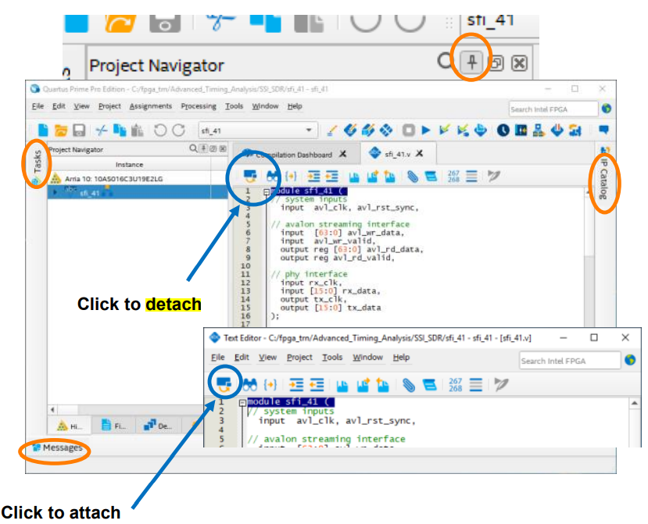
Window Management
Quickly hide/unhide dockable windows by “unpinning”
Hover over a window’s tab to make it temporarily visible
Re-pin to keep the window visible
Detachable Windows
Window menu → Detach/Attach Window
16

Slide 17
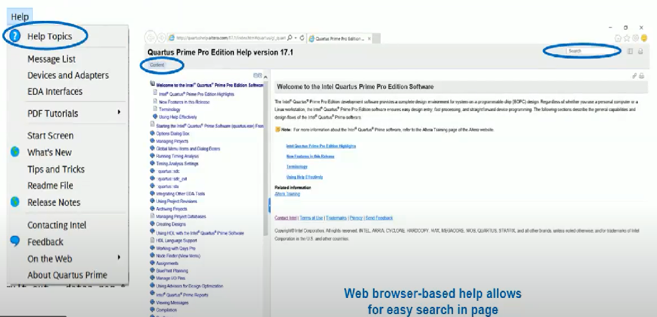
Built-in Help System
17

Slide 18
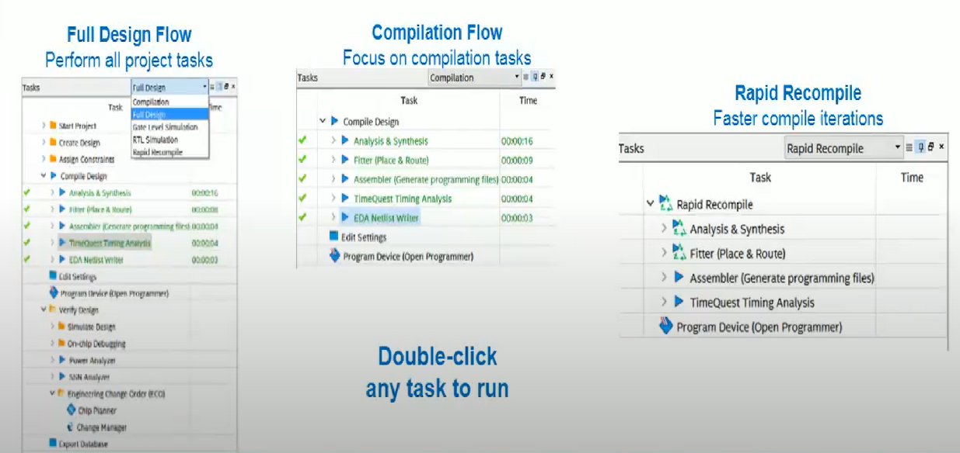
Tasks Window
Easy access to most functions
Organized into related task within task flows
18

Slide 19
Intel Quartus Prime Software Projects
Description
Collection of related design files & libraries
Must have a designated top-level entity
Target a single device
Store setttings in Intel Quartus Prime setting file (.qsf)
Compiled netlist information stored in db folder in project directory
Create new projects with New Project Wizard
Can be created using Tcl scripts
19

Slide 20
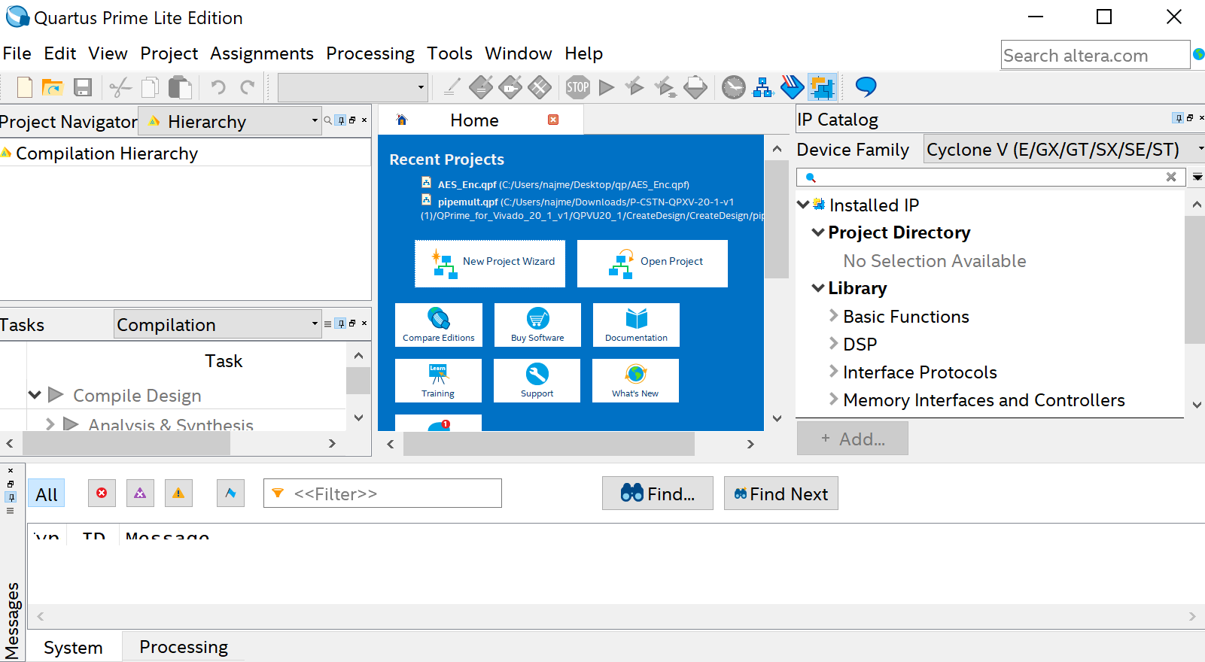
Quartus: Create Project
Introduction to the Intel Quartus Prime Software:
https://www.youtube.com/watch?time_continue=1696&v=Ah6XQUHTumo&feature=emb_title

Slide 21
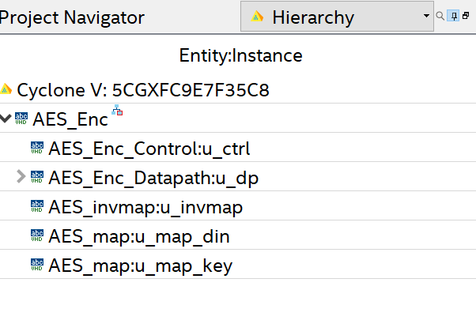
Quartus: Set AES_Enc as Top

Slide 22
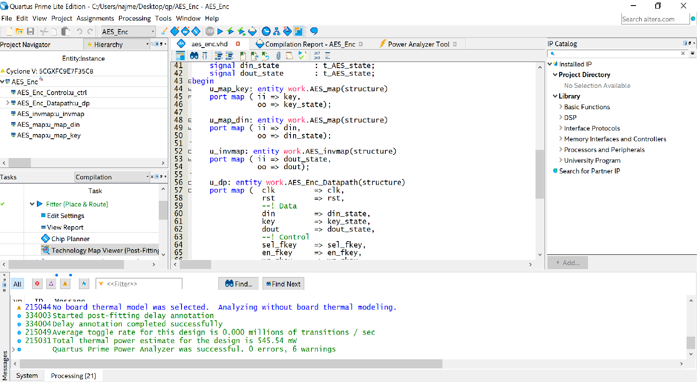

Slide 23
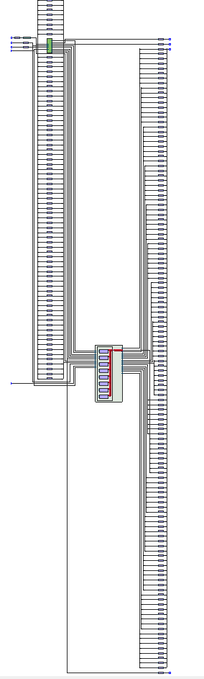
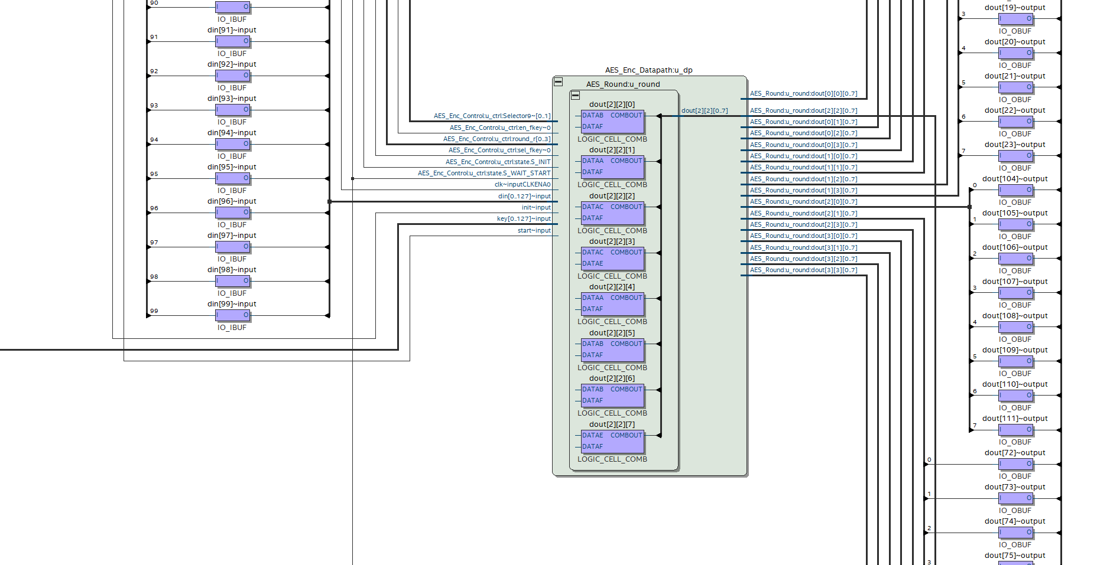
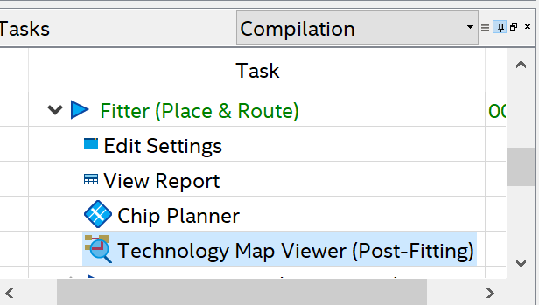
Quartus: Schematic of Design
Open Technology Map Viewer

Slide 24
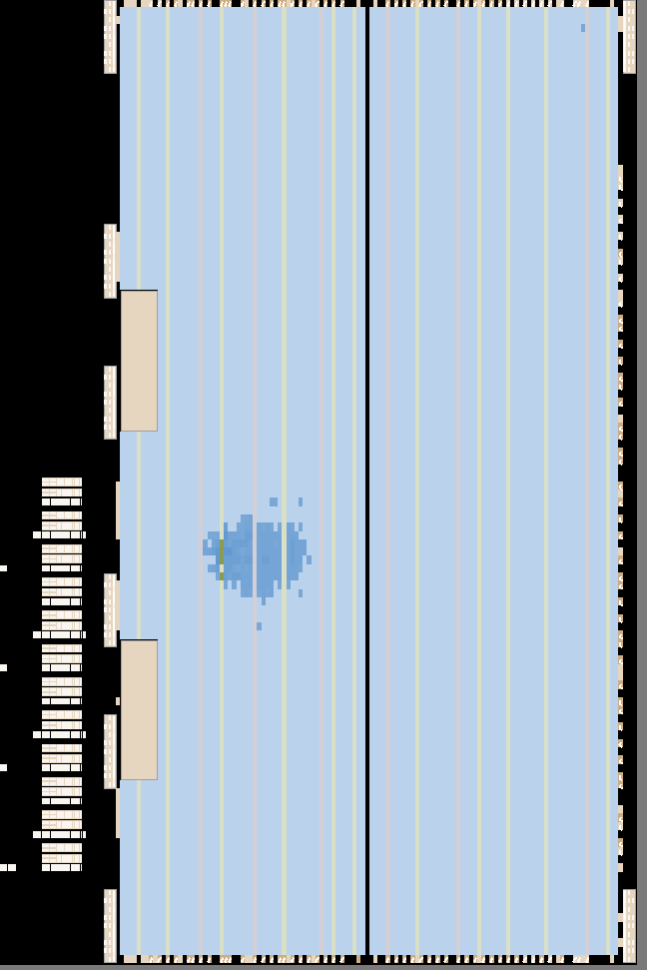
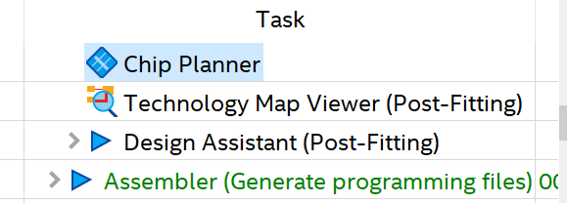
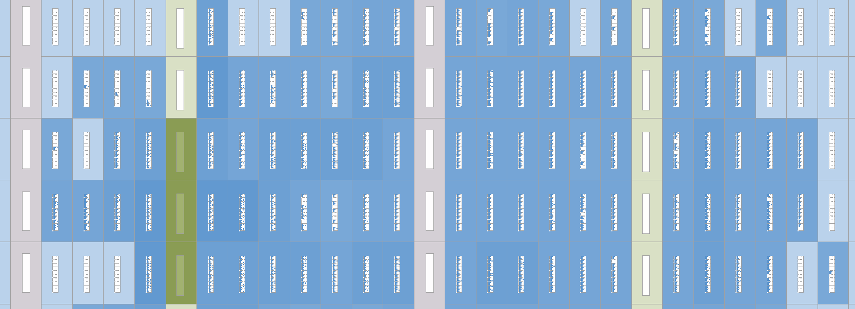
Quartus: Chip Planner
Open chip planner

Slide 25
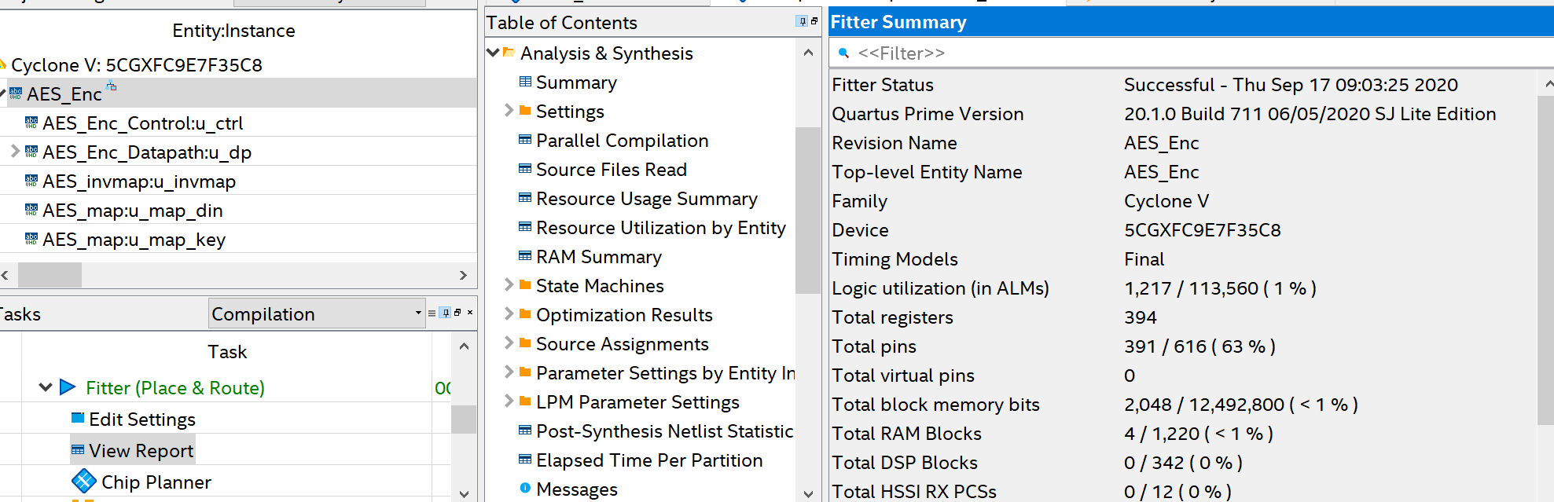
Quartus: Report

Slide 26
Thank you

